Slide 1
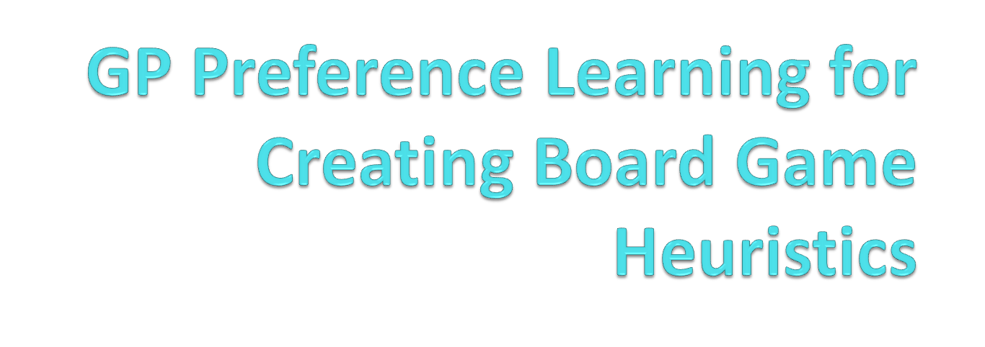
-Vignesh Rao, Y
Media Informatics

Slide 2
Motivation
Calculating the heuristic of a game with full mini-max tree is expensive or unachievable.
Eg: Chess (2.1 X 10⁹⁶ possible nodes)
But we try to achieve this with tree of limited depth ‘d’, by approximation of full tree.

Slide 3
Definitions
The Heuristic function at the leafs of the mini-max tree is :
      f(x) = w^{T} . X_T
      Where,
      w is the weight vector .
      X_T is the game state at time T.
      -we try to learn w from the learning data

Slide 4
Approach
We use Gaussian Process(GP) preference learning from which we find a likelihood function from the preferences in the data set.
We now try to optimize the GP by calculating the new mean and covariance and find an improved weight vector.

Slide 5
Initial Setup
Initially, we sample ‘k’ weight vectors from the GP Prior (w1,w2,..wk) for which we find the preferences by a tournament among them.
Eg: w1>w2
  w3>w4
  w5<w4…. Etc.
    These become the training set from which we learn.

Slide 6
Further Steps
We then find the likelihood function with the above learning data set, and find new mean and covariance for the GP
From this we can find the new weight vector wk+1 which again undergoes tests with previous weights and preferences are added to the training dataset.
We iterate this process for ‘n’ rounds.

Slide 7
Efficiency
For calculating Efficiency of a weight Vector, we first randomly generate ‘N’ random weights.
Now we find the number of wins, losses and draws of our weight vector against ‘N’ weights.
From this we can arrive at a score by a weighted average of wins and draws

Slide 8
Benchmarking
After ‘n’ rounds we try to compute scores for weight vector at each level against the same ‘N’ random weights.
We plot this performance in a graph to find the learning rate w.r.t rounds of our algorithm.

Slide 9
Goal
  We want a heuristic that wins as many matches as possible and we want it as soon as possible too !!

Slide 10
References
Chu, W., & Ghahramani, Z. (2005, August). Preference learning with Gaussian processes. In Proceedings of the 22nd international conference on Machine learning (pp. 137-144). ACM.
Houlsby, N., Huszar, F., Ghahramani, Z., & Hernández-lobato, J. M. (2012). Collaborative gaussian processes for preference learning. In Advances in Neural Information Processing Systems (pp. 2096-2104).
Eric, B., Freitas, N. D., & Ghosh, A. (2008). Active preference learning with discrete choice data. In Advances in neural information processing systems(pp. 409-416).

